Slide 1


K.RAMAKRISHNAN COLLEGE OF ENGINEERING
(AUTONOMOUS)
SMART POWER DISTRIBUTION MANAGEMENT SYSTEM
Presented by ,
Name : GUGANRAJ R
Register No : 8115U25CS050
Roll No : E2518
Year & Section : I-E
      Guided by,
Mrs.R.Nalini,AP/CSE
Date of Review :30/03/2026

Slide 2

PROBLEM STATEMENT
The existing power distribution system uses manual methods to manage consumer details, monitor electricity usage, and handle faults. This process is slow, difficult, and may cause errors during load balancing and fault management. Searching consumer records and generating bills also takes more time.To solve these problems, a Smart Power Distribution Management System is developed using C and Data Structures. The system helps manage consumers, monitor load, control faults, generate bills, and search consumer details quickly and efficiently.

Slide 3
PRESENTATION OVERVIEW
      Objective of the Project
      Data Structures Used
      System Architecture(flow Diagram)
      Modules Used
      Modules Description
      Module Implementation
      Output
      Advantages
      Conclusion

Slide 4

OBJECTIVE OF THE PROJECT
To develop a Smart Power Distribution Management System using C programming.
To manage consumer details efficiently using Linked List.
To search consumer records quickly using Binary Search Tree (BST).
To handle power faults using Queue data structure.
To monitor and balance electrical load distribution.
To generate electricity billing reports automatically.
To improve the efficiency and reliability of power distribution management.
.

Slide 5


DATA STRUCTURES USED
Structure
Linked List
Binary Search Tree
Queue
.
Notes:
5

Slide 6
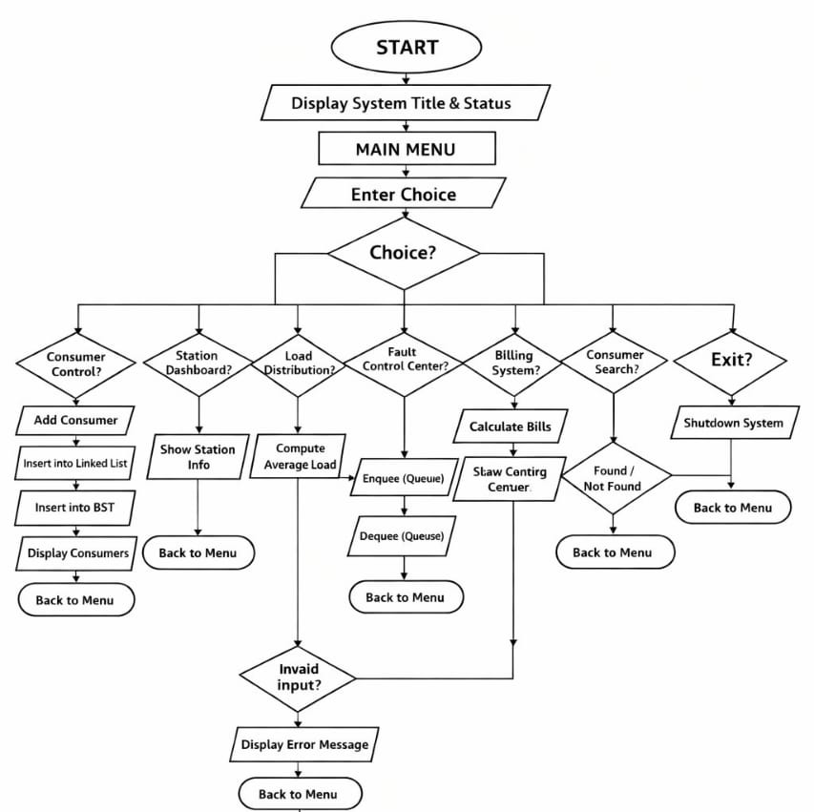
PROPOSED SYSTEM
ARCHITECTURE/FLOW DIAGRAM
.

Slide 7
MODULES USED
Consumer
Power Station Details
Load Checking
Fault Control
Bill Report
Consumer Status
Shutdown
.

Slide 8
MODULES & ITS DESCRIPTION
1.Consumer Module :
The Consumer module is used to register and manage electricity consumer details in the system. It stores information such as Consumer ID, consumer name, location, and energy usage. The records are maintained using a Linked List data structure for efficient data handling and storage. This module helps the operator easily add and display consumer information. It improves the management and monitoring of consumers in the smart power distribution network.

Slide 9
MODULES & ITS DESCRIPTION
2. Power Station Details Module :
The Power Station Details module displays the current status of the power station and substations. It provides information such as station name, active substations, and load condition. This module helps monitor the overall performance of the power distribution system. It ensures that the electricity supply is operating normally without interruptions. The module acts as the control center of the smart grid system.

Slide 10
MODULES & ITS DESCRIPTION
3. Load Checking Module :
The Load Checking module is used to monitor and calculate the total electrical load consumed by consumers. It calculates the total load demand and average power usage in the network. This module helps identify overload conditions and maintain balanced power distribution. It improves the efficiency and stability of the smart power grid. Proper load checking helps avoid power failures and system overloads.

Slide 11
MODULES & ITS DESCRIPTION
4. Fault Control Module :
The Fault Control module is responsible for handling and managing power faults in the distribution system. Fault requests are stored in a Queue data structure and processed in FIFO order. This module helps quickly detect and resolve faults in the power line. After fault resolution, the system restores the electricity supply successfully. It improves reliability and reduces downtime in the smart grid network.

Slide 12
MODULES & ITS DESCRIPTION
5. Bill Report Module :
The Fault Control module is responsible for handling and managing power faults in the distribution system. Fault requests are stored in a Queue data structure and processed in FIFO order. This module helps quickly detect and resolve faults in the power line. After fault resolution, the system restores the electricity supply successfully. It improves reliability and reduces downtime in the smart grid network.

Slide 13
MODULES & ITS DESCRIPTION
6. Consumer Status Module :
The Consumer Status module is used to search and verify consumer details in the system. It uses a Binary Search Tree (BST) to perform fast searching using Consumer ID. When a consumer is found, the system displays the active status and power supply condition. This module improves searching efficiency compared to traditional searching methods. It helps operators quickly access consumer information in the network.

Slide 14
MODULES & ITS DESCRIPTION
7. Shutdown Module :
The Shutdown module is used to safely terminate the Smart Power Distribution Management System. It closes all running operations and displays system shutdown messages. This module ensures that the program ends without affecting ongoing processes. It provides secure and proper termination of the application. The shutdown operation marks the completion of system execution.

Slide 15
MODULE IMPLEMENTATION
void searchBST(struct BST* root, int id) {
if (!root) {
printf("\n❌ Consumer Not Found!\n");
return; }
if (root->id == id) {
printf("\n✔ Consumer Found in Network\n");
printf("Status: ACTIVE | Supply: NORMAL\n");
return; }
if (id < root->id)
searchBST(root->left, id);
else
searchBST(root->right, id);}
/// ================= CONSUMER MANAGEMENT =================
void addConsumer() {
struct Consumer* newNode = malloc(sizeof(struct Consumer));
printf("\n➤ Registering New Consumer...\n\n");
printf("Consumer ID : ");
scanf("%d", &newNode->id);
printf("Name : ");
scanf("%s", newNode->name);
printf("Location : ");
scanf("%s", newNode->location);
printf("Energy Usage : ");
scanf("%f", &newNode->units);
newNode->next = head;
head = newNode;
root = insertBST(root, newNode->id);
printf("\n✔ Consumer Successfully Integrated into Grid\n");}
void displayConsumers() {
struct Consumer* temp = head;
printf("\n[ACTIVE CONSUMERS]\n");
printf("----------------------------------------------------\n");
#include <stdio.h>
#include <stdlib.h>
#include <string.h>
/// ================= LINKED LIST =================
struct Consumer {
int id;
char name[50];
char location[50];
float units;
struct Consumer* next;};
struct Consumer* head = NULL;
/// ================= BST =================
struct BST {
int id;
struct BST *left, *right;};
struct BST* root = NULL;
/// ================= QUEUE =================
#define MAX 10
int queue[MAX], front = -1, rear = -1;
/// ================= BST FUNCTIONS =================
struct BST* insertBST(struct BST* root, int id) {
if (!root) {
struct BST* newNode = malloc(sizeof(struct BST));
newNode->id = id;
newNode->left = newNode->right = NULL;
return newNode}
if (id < root->id)
root->left = insertBST(root->left, id);
else
root->right = insertBST(root->right, id);
return root;}

Slide 16
MODULE IMPLEMENTATION
while (temp != NULL) {
printf("ID: %d | Name: %-6s | Area: %-10s | Load: %.0f Units\n",
temp->id, temp->name, temp->location, temp->units);
temp = temp->next; }
printf("----------------------------------------------------\n");}
/// ================= LOAD BALANCING =================
void loadBalancing() {
struct Consumer* temp = head;
float total = 0;
int count = 0;
while (temp) {
total += temp->units;
count++;
temp = temp->next; }
printf("\n[LOAD DISTRIBUTION MONITOR]\n");
printf("----------------------------------------------------\n");
if (count == 0) {
printf("No Data Available\n");
return; }
printf("Total Consumers : %d\n", count);
printf("Total Load Demand : %.0f Units\n", total);
printf("Average Load : %.0f Units\n", total / count);
printf("\n✔ Load Balanced Across Substations\n");
printf("✔ No Overload Detected\n");
printf("----------------------------------------------------\n");}
/// ================= FAULT MANAGEMENT =================
void enqueue(int id) {
if (rear == MAX - 1) {
printf("Queue Full!\n");return; } if (front == -1) front = 0;
queue[++rear] = id;
printf("\n⚠️ Fault Logged Successfully → Sent to Service Queue\n");}
void dequeue() {
if (front == -1 || front > rear) {
printf("No Faults!\n");
return; }
printf("\n🔧 Resolving Fault ID: %d...\n", queue[front++]);
printf("✔ Power Restored Successfully\n");}
/// ================= BILLING =================
void billing() {
struct Consumer* temp = head;
printf("\n[ENERGY BILLING REPORT]\n");
printf("----------------------------------------------------\n");
while (temp) {
printf("ID: %d | %-6s | Units: %.0f | Bill: ₹%.0f\n",
temp->id, temp->name, temp->units, temp->units * 5);
temp = temp->next; }
printf("\n✔ Reports Generated Successfully\n");
printf("----------------------------------------------------\n");}
/// ================= STATION =================
void stationDashboard() {
printf("\n[POWER STATION DASHBOARD]\n");
printf("----------------------------------------------------\n");
printf("Station Name : Chennai Main Grid\n");
printf("Substations : 3 Active\n");
printf("Current Load : Stable\n");
printf("\n✔ Power Distribution Running Normally\n");
printf("----------------------------------------------------\n");}
/// ================= MAIN =================
int main() { int choice, sub, id;
printf("====================================================\n");

Slide 17
MODULE IMPLEMENTATION
printf(" ⚡ TNEB SMART POWER DISTRIBUTION SYSTEM ⚡\n");
printf("====================================================\n");
printf("Status : ONLINE\n");
printf("Region : Tamil Nadu Grid\n");
printf("Control Mode : Automatic\n");
printf("====================================================\n");
while (1) {
printf("\nMAIN MENU\n");
printf("----------------------------------------------------\n");
printf("1. 👤 Consumer Control Panel\n");
printf("2. 🏭 Power Station Dashboard\n");
printf("3. ⚖️ Load Distribution Monitor\n");
printf("4. 🚨 Fault Control Center\n");
printf("5. 💰 Billing & Energy Report\n");
printf("6. 🔍 Consumer Lookup\n");
printf("7. ❌ Shutdown System\n");
printf("----------------------------------------------------\n");
printf("Enter Command: ");
scanf("%d", &choice);
switch (choice) {
case 1:
addConsumer();
displayConsumers();
break;
case 2:
stationDashboard();
break;
case 3:
loadBalancing();
break;
case 4:
printf("\n[FAULT CONTROL CENTER]\n");
printf("1. Report Fault\n2. Resolve Fault\n");
printf("Enter Option: ");
scanf("%d", &sub);
if (sub == 1) {
printf("\nFault ID : ");
scanf("%d", &id);
printf("Fault Location : Line\n");
enqueue(id);
} else {
dequeue();
}
break;
case 5:
billing();
break;
case 6:
printf("\n[CONSUMER SEARCH]\n");
printf("Enter Consumer ID: ");
scanf("%d", &id);
searchBST(root, id);
break;
case 7:
printf("\n⚡ System Shutting Down...\n");
printf("✔ Thank You for Using Smart Grid System\n");
exit(0);
default:
printf("Invalid Command!\n"); } }}

Slide 18
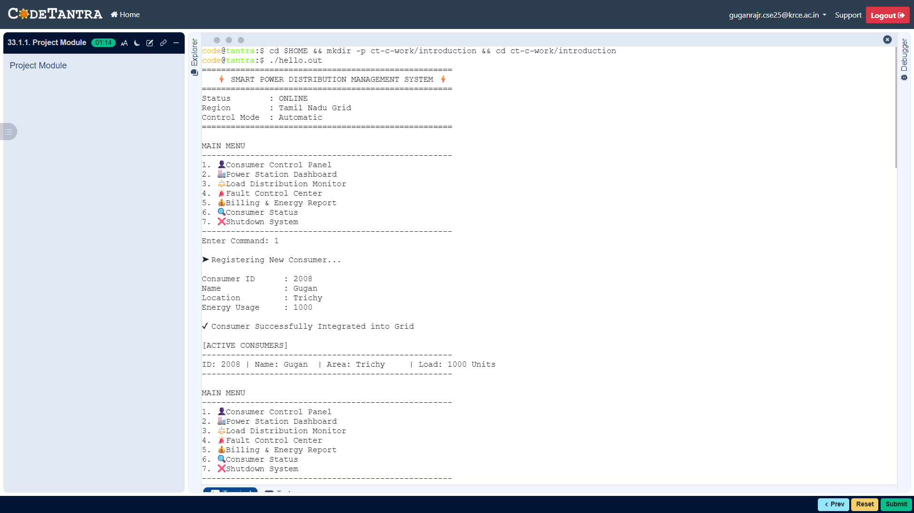
OUTPUT
1.ADD A CONSUMER :
Notes:
12

Slide 19
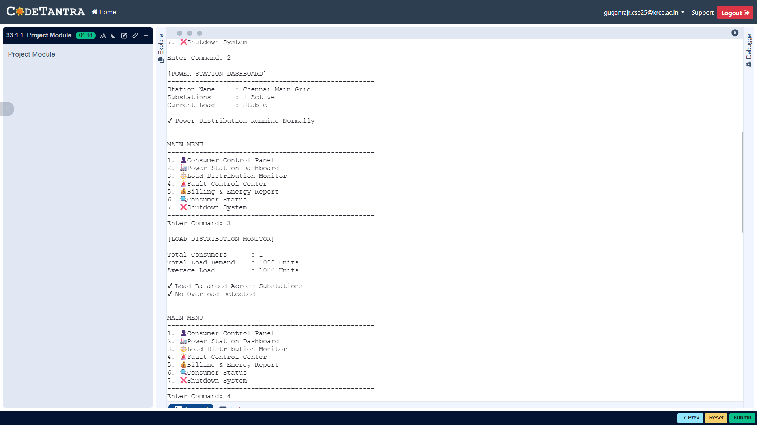
OUTPUT
2.POWER STATION DETAILS :
Notes:
13

Slide 20
OUTPUT
3. LOAD CHECKING :
Notes:
13

Slide 21
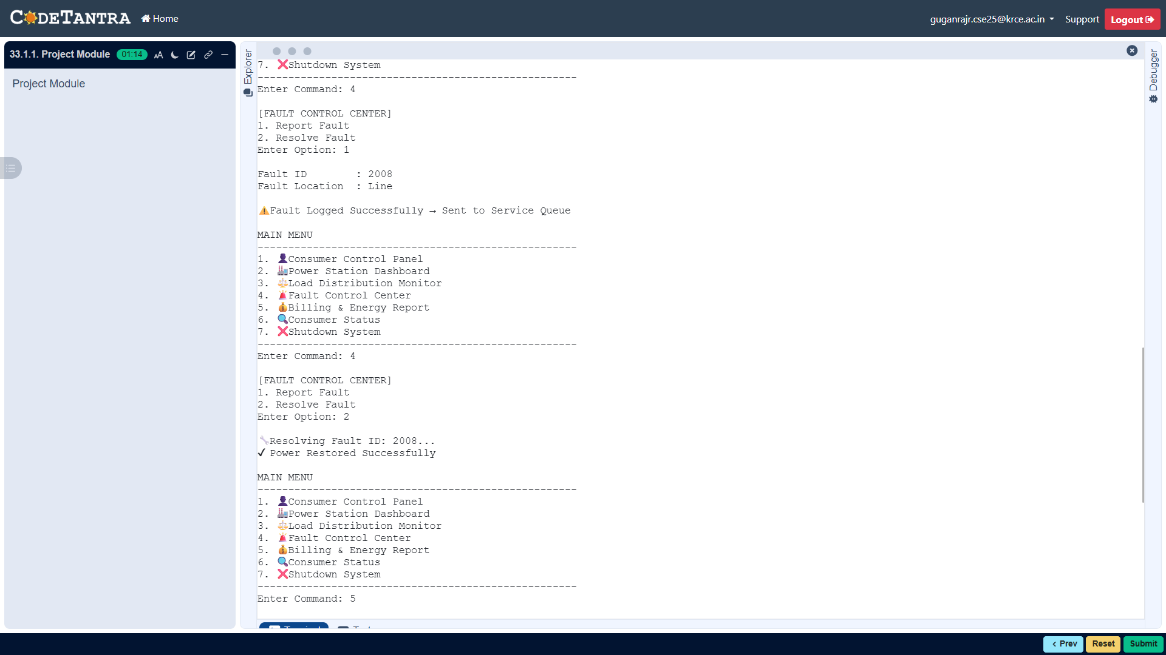
OUTPUT
4. FAULT CONTROL :
Notes:
13

Slide 22
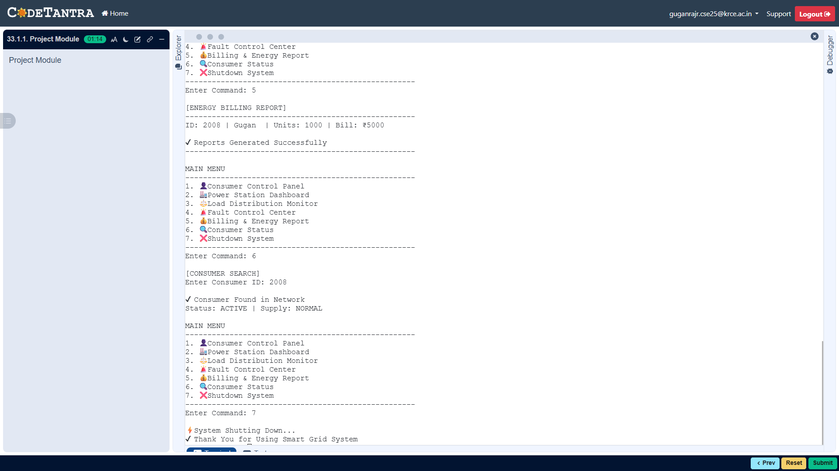
OUTPUT
5. BILL REPORT :
Notes:
13

Slide 23
OUTPUT
6. CONSUMER STATUS :
Notes:
13

Slide 24
OUTPUT
7. SHUTDOWN :
Notes:
13

Slide 25
ADVANTAGES
Easy management of consumer records.
Fast searching using Binary Search Tree (BST).
Efficient fault handling using Queue.
Automatic electricity bill generation.
Proper load monitoring and balancing.
Reduces manual work and errors.

Slide 26
CONCLUSION
  The Smart Power Distribution Management System is an efficient application developed using C programming and data structures. The system successfully manages consumer records, monitors electrical load, handles power faults, generates billing reports, and searches consumer information effectively. Different data structures such as Linked List, Binary Search Tree, and Queue are used to improve system performance and efficiency. The project reduces manual work and helps maintain reliable power distribution management.

Slide 27
FUTURE ENHANCEMENT
1. IoT-Based Power Monitoring :
The system can be integrated with IoT sensors to monitor electricity usage and power faults in real time.
2. Online Billing and Mobile Support :
Online bill payment and mobile application support can be added in the future. This will allow consumers and operators to access the system easily from anywhere.
3. Automatic Fault Detection :
The system can be enhanced with automatic fault detection and alert notification features.

Slide 28
THANK YOU 🙏🏿

